Slide 1

Exploratory Data Analysis II

Slide 2
EDA Defined
Remember the Process
Be the Process
Data
Question
Visualize Summarize
Model
Data

Slide 3
EDA Purpose
Purpose of Asking Questions and Exploring Those Questions Using Visualizations and Summaries is to Spot Patterns
Ask Yourself:
Is it Coincidence?
How Strong is the Relationship?
What Variables May Be Confounding?
Do Subgroups Cause the Relationship to Change?
How Can You Model the Pattern?

Slide 4
EDA Mantra
“Be the change
that you want to see in the world
unless that change is statistically
insignificant.”
- Mahatma Mario

Slide 5

Question
What is the relationship between
the size of the
and
the price of the ?

Slide 6
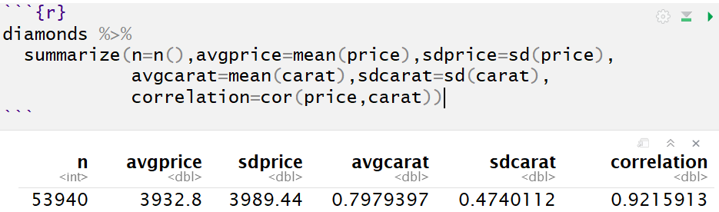
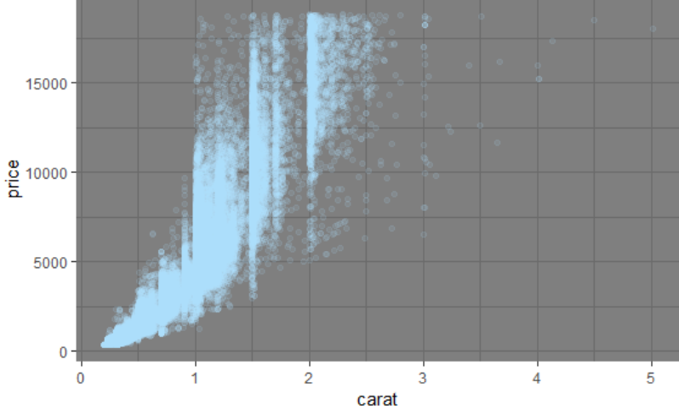
Visualize Summarize

Slide 7
Question
Refined Questions
Is the Observed Relationship Spurious?
Can I Represent the Relationship Using a Linear Model?
Should I Use an Exponential Model to Represent the Relationship?
Does Another Variable Exist to Explain the Drastic Change in Spread?

Slide 8
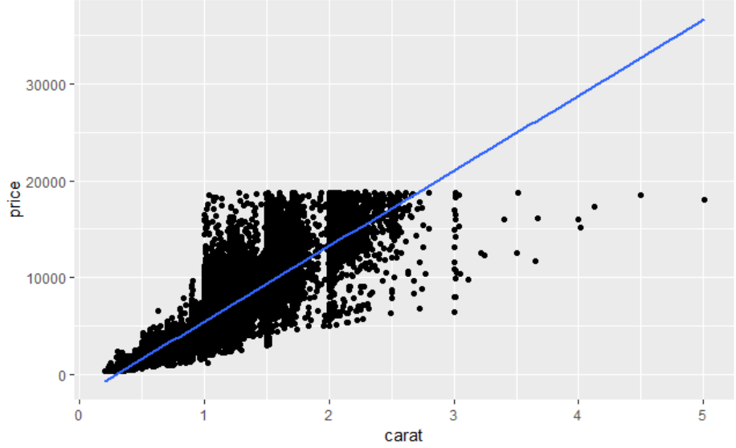
Model
Linear Model

Slide 9
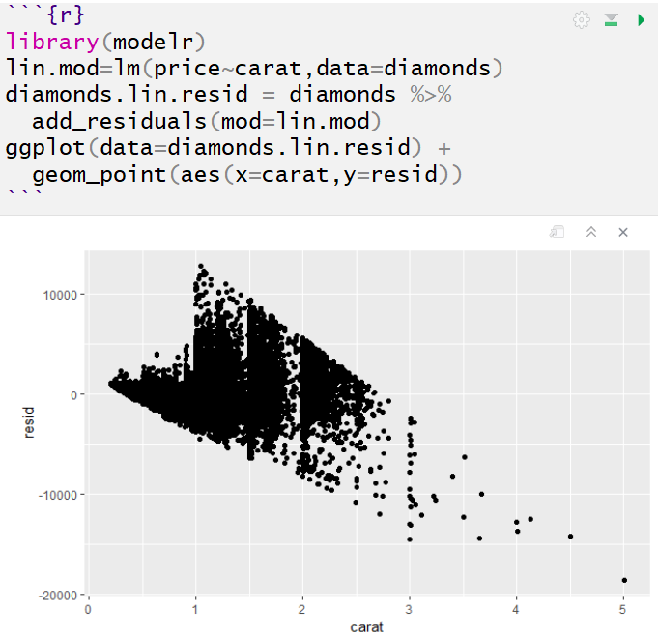
Model
Linear Model

Slide 10
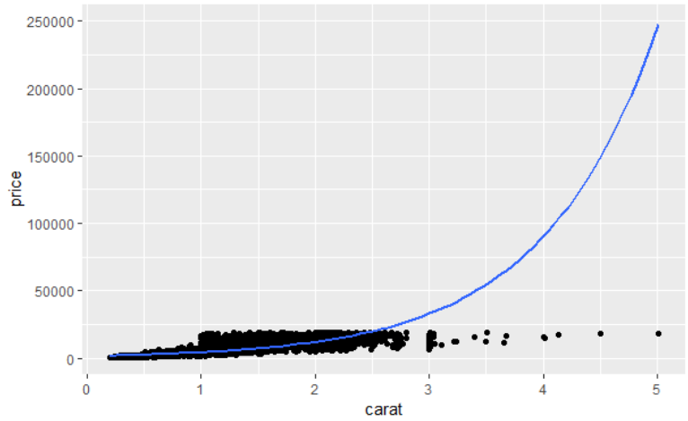
Model
Exponential Model

Slide 11
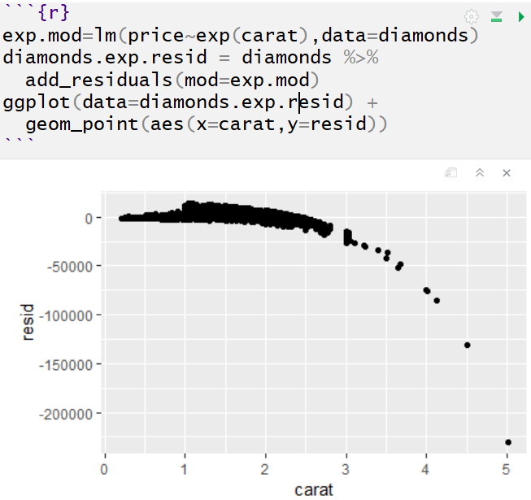
Model
Exponential Model

Slide 12
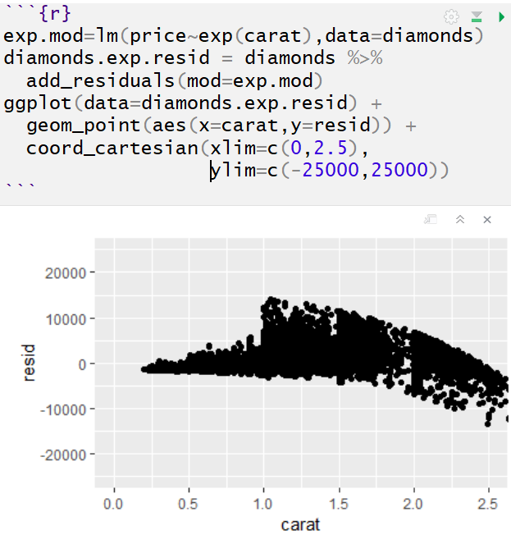
Model
Exponential Model

Slide 13
Closing
Disperse and Make Reasonable Decisions

